Slide 1
Why is mutability such a pain in JavaScript?
front.jit (29.03.2023)

Slide 2

Today’s agenda
Motivation and real-life examples
Pros and cons of immutability
How to handle immutability in JS

Slide 3

Maciej Kankowski
In Jit Team for 5 years 🤠
Frontend (React/Next/Vue + 🎨)
Mobile (🍏)
Internal projects / mentoring 🧑🏼‍🎓 👨🏼‍🎓
Travel, drones, books, cars 🚀

Slide 4

Motivation
Bugs and hard debugging
Discover problems quickly
Ways to avoid accidental object mutations

Slide 5
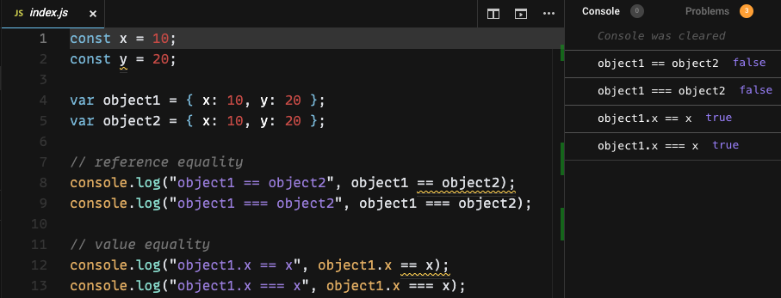
Example: Reference vs value equality
https://codesandbox.io/s/js-reference-vs-value-equality-zb2rdt?file=/src/index.js

Slide 6
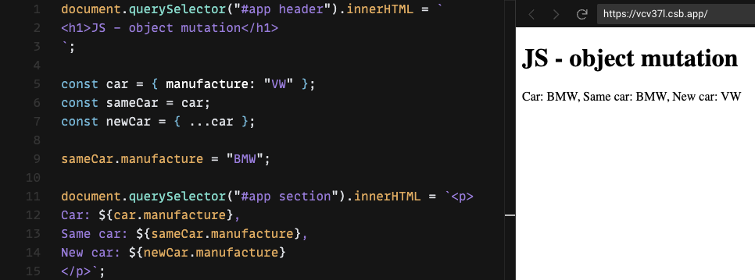
Example: Object mutation
https://codesandbox.io/s/js-object-mutation-vcv37l?file=/src/index.js

Slide 7
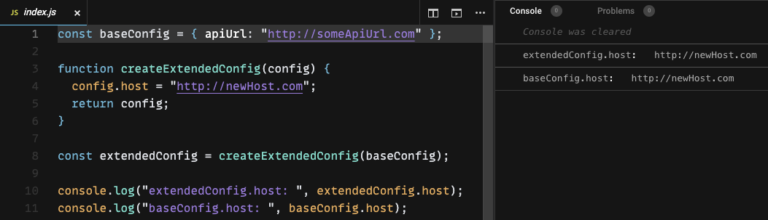
Example: Object mutation (from function)
https://codesandbox.io/s/js-object-mutation-from-function-k2uyen?file=/src/index.js

Slide 8
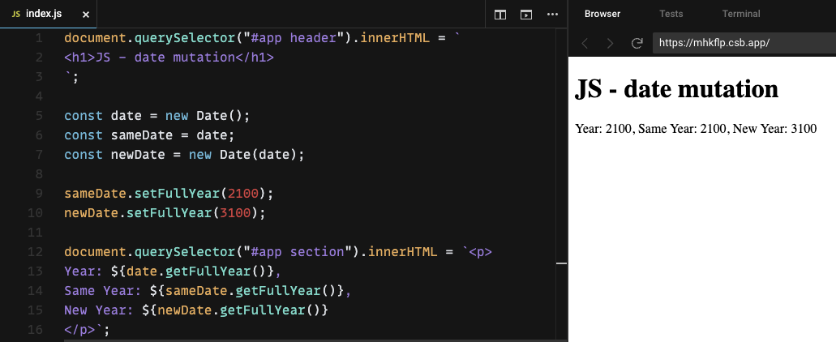
Example: Date object mutation
https://codesandbox.io/s/js-date-mutation-mhkflp?file=/src/index.js

Slide 9
Pros & cons of immutability
But before, what is data immutabiliy?
Simpler programming and debugging
Immutable data is slower than mutable
DOM rendering, database quering etc. is even much slower
Being aware of working with reference and values data types
Being aware of working with shallow and deep comparision
It matters in ”reactive” frameworks like React.js, Vue.js…

Slide 10
How to handle immutability in JS
Reduce the usage of mutative functions like push, unshift or splice
Use shallow-copying functions like map, filter or reduce
const vs Object.freeze() (runtime)
readonly - Typescript modificator (compile-time only)
Immer.js, immutable.js
React: useDeepCompare, shouldComponentUpdate (memo)
Pure Function
Deep & shallow clone methods…

Slide 11
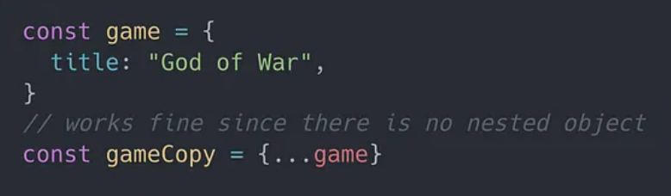
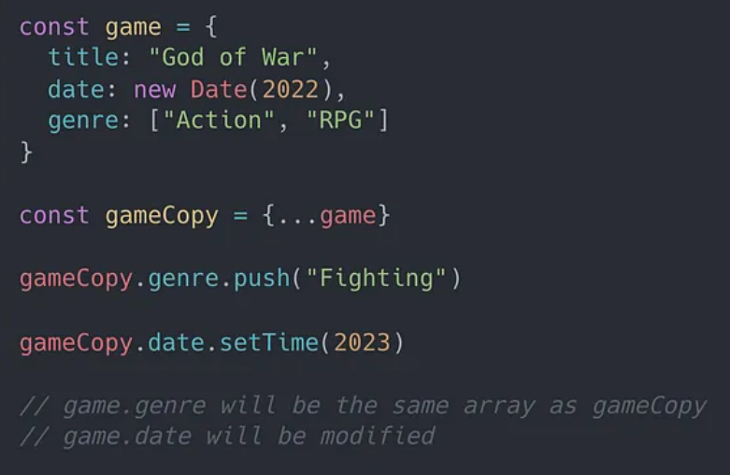
Shallow clone methods
Object.assign(), spread operator
✅
❌

Slide 12
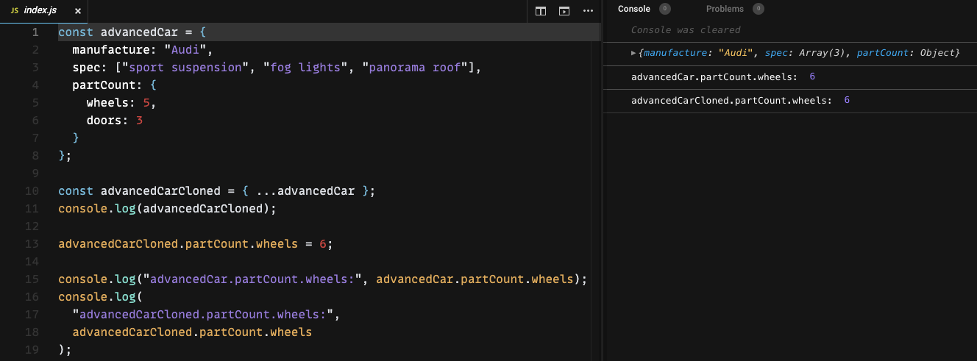
Shallow clone methods
Object.assign(), spread operator
❌
https://codesandbox.io/s/js-shallow-merge-ow7jgq?file=/src/index.js

Slide 13
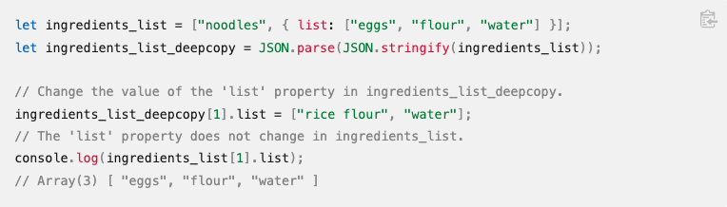
Shallow clone methods: JSON api
JSON.stringify(), JSON.parse()
Basic objects, arrays, primitives
⚠️ Functions, Symbols, objects that represent HTML, recursive data… cannot be serialized
✅

Slide 14
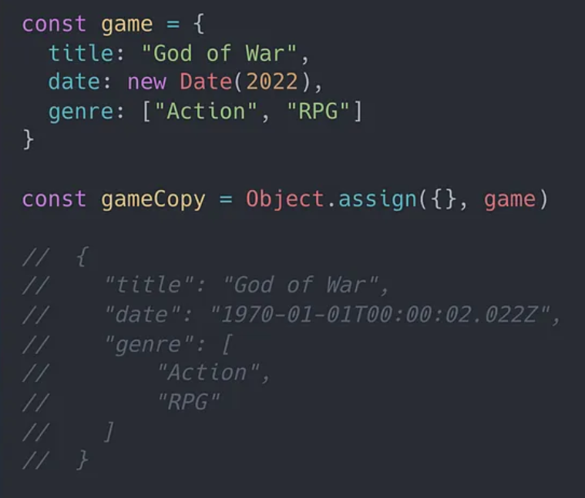
Shallow clone methods: JSON api
JSON.stringify(), JSON.parse()
Basic objects, arrays, primitives
⚠️ Functions, Symbols, objects that represent HTML, recursive data… cannot be serialized
❌

Slide 15
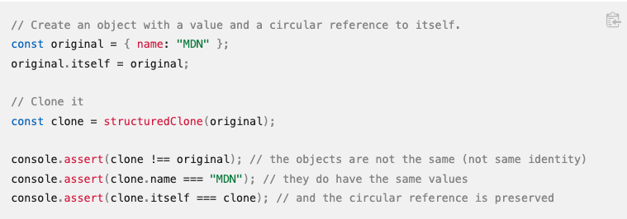
Deep clone methods: structuredClone
Original values to be transferred rather than cloned to the new object.
It’s browser (or Javascript runtime) feature rather than JavaScript language itself (window)
⚠️ The same serialization issues like JSON.stringify()
✅

Slide 16
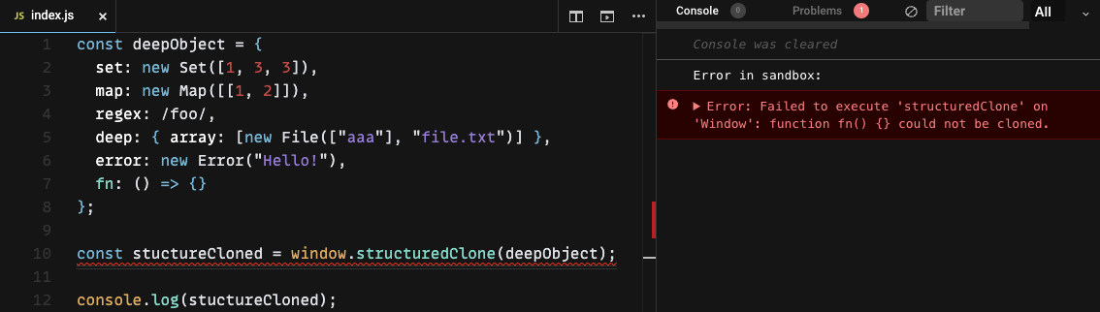
Deep clone methods: structuredClone
Original values to be transferred rather than cloned to the new object.
It’s browser (or Javascript runtime) feature rather than JavaScript language itself (window)
⚠️ The same serialization issues like JSON.stringify() https://codesandbox.io/s/js-window-structuredclone-xkt0i7
❌

Slide 17
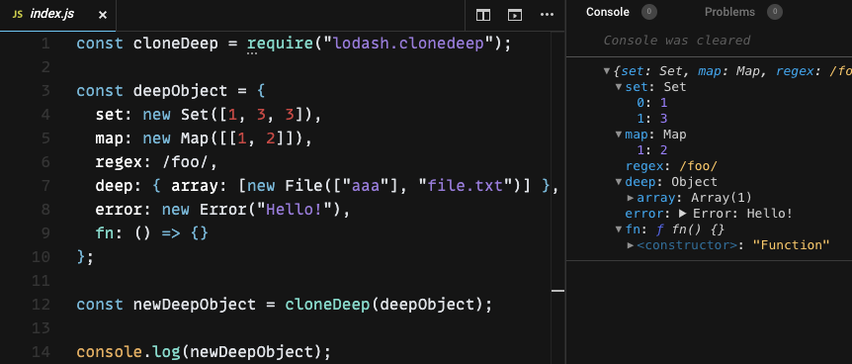
Deep clone methods: external libraries
Lodash (_.cloneDeep), Ramda
Structural sharing
Bundle size
✅

Slide 18
Conclusions
Bugs & debbuging: Working with immutable data prevents the developers to avoid accidental changs
Performance impact: DOM renders is much slower than using immutable data
Shallow (vs. Deep) comparition is a better performant so it’s a default solution for React, Redux etc.
„Immutable libraries such as Immer can employ structural sharing, which effectively returns a new object that reuses much of the existing object being copied from”

Slide 19


Slide 20
References
https://developer.mozilla.org/en-US/docs/Glossary/Shallow_copy
https://developer.mozilla.org/en-US/docs/Glossary/Deep_copy
https://redux.js.org/faq/immutable-data
https://daveceddia.com/react-redux-immutability-guide/
https://reactkungfu.com/2015/08/pros-and-cons-of-using-immutability-with-react-js/
https://blog.klipse.tech/javascript/2021/02/26/structural-sharing-in-javascript.html
https://javascript.plainenglish.io/deep-clone-objects-the-right-way-in-javascript-a7ded9d23860
https://monsterlessons-academy.com/posts/mutable-and-immutable-data-in-javascript
https://www.builder.io/blog/structured-clone

